Slide 1
Scholastic Data Science Case Study Presentation
Ajay Kallepalli

Slide 2
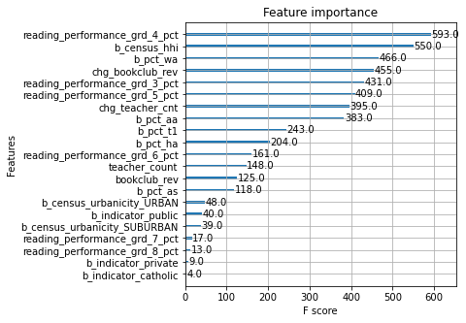
Question 3) Summary of findings
Guiding objective: identifying and interpreting the features of schools that correspond to having a large number of magazine subscriptions.
Two main Graphs:
1) Feature importance, F score
This graph shows, essentially, how many times
a variable was split into different segments and
used to build the model. I would not use this for
specific recommendations of what to focus on.

Slide 3
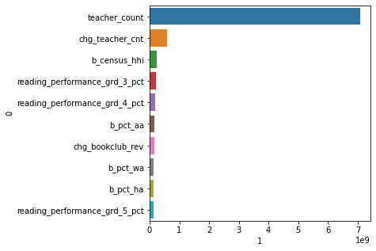
Summary of findings
2) Feature importance, total gain
This graph shows how much each variable
makes the prediction error fall in total.
My interpretation of the data would lead me to
use this graph as the basis for recommendations.
In the case of identifying schools with the most
upselling potential teacher count, change in teacher count,
and household income are the most important variables.

